Slide 1
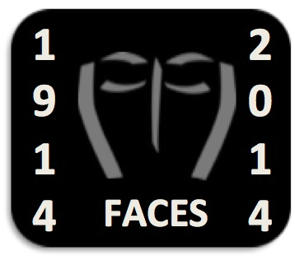
Disfigurement and Representing the Face
University of Exeter
Institut Faire Faces
Marjorie Gehrhardt
David Houston Jones

Slide 2
The Facially injured soldiers of the First World War

Slide 3
Henry Tonks pastel, Royal College of Surgeons of England

Slide 4
During the First World War very large numbers of servicemen received facial injuries.
Estimates put the numbers of facially injured at over 60,000 in the UK alone. Their wounds required complex and difficult surgery, which led to the development of new techniques.
The slides you are looking at show portraits of injured servicemen by the artist Henry Tonks, along with photographic records.

Slide 5
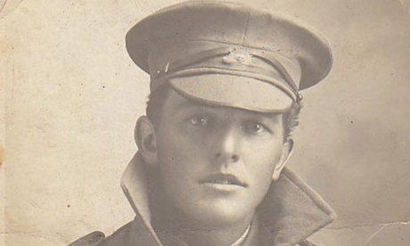
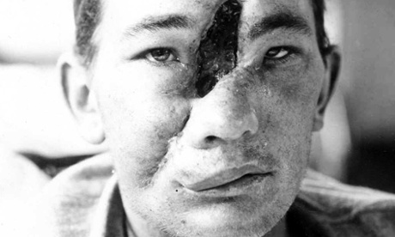
Photograph: Australian War Memorial (P10965.001

Slide 6
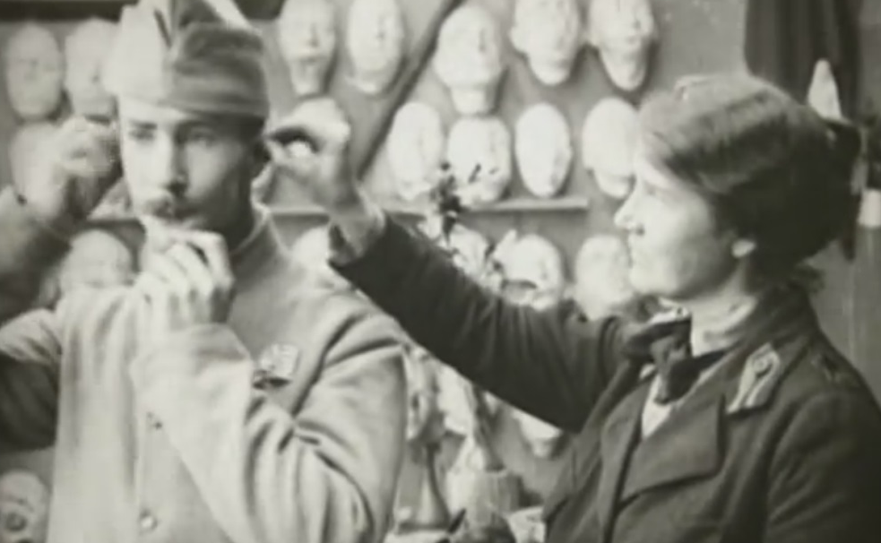
Anna Coleman Ladd, Red Cross Studio, Paris
Sculptors as mask-makers:
Anna Coleman Ladd and Francis Derwent Wood

Slide 7
The sculptor Francis Derwent Wood working at the ‘Tin Noses Workshop’ in the 3rd London General hospital
© IWM (Q 30457

Slide 8
Discussion points
Can you see what Derwent Wood and Anna Colema Ladd are doing?
Why do you think surgeons, artists and sculptors worked together so much in the context of First World War facial injury?

Slide 9
Simon Weston

Slide 10
Simon Weston served in the Falklands and was on board the Sir Galahad when it came under attack in 1982. Twenty two members of his platoon died, and Weston himself suffered 46% burns to his body and face. He subsequently underwent more than 90 operations to reconstruct his face.

Slide 11
Extract, The People’s Portrait
http://www.youtube.com/watch?v=RN7oMEd4Kyw
Fiona Bruce follows Falklands War hero Simon Weston over three months, as he becomes the first person chosen by the public to be painted for the National Portrait Gallery.

Slide 12
Simon Weston
How does Simon’s story make us think about disfigurement?
What personal qualities does it show?
What does the portrait of Simon in the National Portrait Gallery tell us?

Slide 13
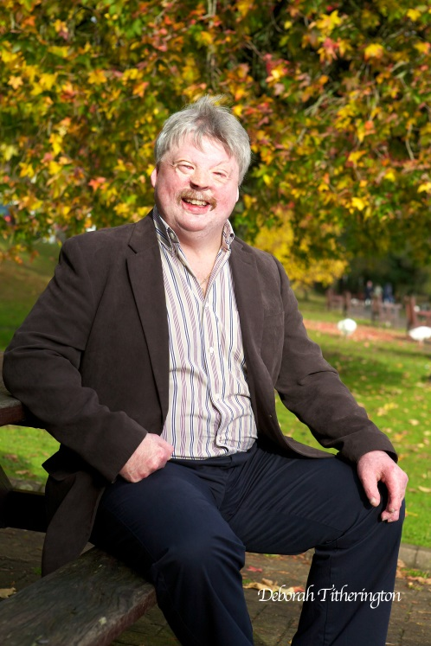
http://www.dailymail.co.uk/news/article-2129450/SIMON-WESTON-talks-movingly-surprise-grandchild-reunited-wayward-son.html
This newspaper article gives a different perspective on Simon Weston and his experiences
What aspects of Simon’s life does it emphasise?
Why is it important to talk about family context as well as Simon’s experiences in the Falklands?

Slide 14
Moshi Monsters: Freakface
The character ‘Freakface’ appears in the children’s website Moshi Monsters. Some of the characters (‘monsters’ and ‘moshlings’) do not have visible body parts, but all have faces of some description. ‘Freakface’ is described in the following terms on the Moshi Monsters website:
Freakface is a greenish-blue slobberish Glump, like Fabio, he was also named by Mr. Moshi, with dribble oozing from his mucky pink mouth. He also has a drop dead piece of yellowish hair hanging from his forehead. He has a purple blotch on each side of his face and two oddly shaped teeth-one small blunt one and another taller spiked tooth. http://moshimonsters.wikia.com/wiki/Freakface

Slide 15
Freakface
What kind of representation is this?
What does it suggest about disfigurement?
Do you agree?
How should we react to this sort of representation?

Slide 16
Isabelle Dinoire (Face transplant)
Isabelle Dinoire / Institut Faire Faces

Slide 17
First partial face transplant, 2005
In November 2005 Isabelle Dinoire became the first person in the world to receive a partial face transplant. The operation was carried out by Prof Bernard Devauchelle and his team at the University hospital of Amiens. Mme Dinoire was rushed to hospital after her dog had mauled her and torn off her nose, lips and chin. She had no memory of what happened. After taking sleeping pills, all she could remember was waking up to the sight of blood.
See
http://www.nytimes.com/2005/12/14/science/14face.html?pagewanted=all&_r=0
http://news.bbc.co.uk/1/hi/health/6058696.stm

Slide 18
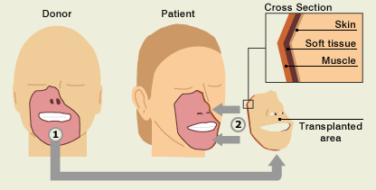
Face transplant

Slide 19
First partial face transplant
What do surgeons have to think about when planning a face transplant?
Does this sort of operation raise ethical questions (questions about right and wrong)?
What do you think would be the effect of a face transplant on a person’s identity?

Slide 20
Paddy Hartley, Walter Yeo

Slide 21
Paddy Hartley, Uniform sculptures
The artist Paddy Hartley has created ‘uniform sculptures’ inspired by the stories of facially injured servicemen of World War One. Although the facial features of the soldiers are not depicted conventionally, their stories, including their life-changing surgery, are told through digital embroidery.
http://paddyhartley.com/introduction/

Slide 25
Paddy Hartley
What kind of representations are these?
What do they tell us about disfigurement?
Why do you think most of the face is left blank?
Identify the materials and forms used (including maps, letters, flags)
What do these materials and forms tell us?

Slide 26
R.J.Palacio, Wonder (2013).

Slide 27
Reading Wonder
Palacio’s Wonder tells the story of a boy born with a disfigurement. In the story, he is about to go to a mainstream school for the first time.
Read the chapter in Wonder entitled ‘Costumes’ (text available in Teacher’s Pack).

Slide 28
What is your first impression of the chapter?
How is this changed by the knowledge that Auggie, the main character, has a disfigurement?
Why does Auggie like Halloween?
What do you think of the role of costume in the way Auggie feels about himself?

Slide 29
Auggie also mentions that he used to wear an astronaut helmet when he was small:
When I was little, I used to wear an astronaut helmet everywhere I went. To the playground. To the supermarket. To pick Via up from school. Even in the middle of summer, though it was so hot my face would sweat. I think I wore it for a couple of years, but I had to stop wearing it when I had my eye surgery

Slide 30
What does the extract tell us about Auggie?
Later on, we find out that Auggie’s dad threw the helmet away. What are the implications of his actions?
What does the extract tell you about Auggie’s relationship with his dad?
How do you understand the statement ‘I love this face of yours, Auggie’?
What do you think of the decision to use the form of the novel to tell a story about disfigurement?
How can fiction help us address real-life issues?

Slide 31
Discussion points
Which of these examples raise ethical issues?
How can we decide what is right and wrong in each case?
How do these contemporary representations make us think about the face?
Can visual representations of the face help us think about ethical issues?
What do these examples tell us about personal identity?
How is our identity reflected in the face?
Can visual representations of the face help us think about personal identity?
How do we react to disfigurement?
How do these examples represent disfigurement?
How should they represent disfigurement?
Do these representations change how we think about disfigurement?

Slide 32
Credits
Images by Henry Tonks © Hunterian Museum at the Royal College of Surgeons of England
Images from Harold Gillies medical files are from the Archives of the Royal College of Surgeons of England
References to Wonder by R J Palacio are by kind permission of Penguin Random House
To find out more about Wonder visit: http://wonderthebook.co.uk/
To buy a copy of Wonder visit: http://amzn.to/1issZnv
Images of Simon Weston: Deborah Titherington
Works by Paddy Hartley: by kind permission of the artist
Image of Isabelle Dinoire: Isabelle Dinoire / Institut Faire Faces
Grateful thanks to Jane Frances (Changing Faces), Simon Robbins (Imperial War Museum) and Florie Dournel (Conseil Général de la Somme).
See also Changing Faces Face Equality Resources:
https://www.changingfaces.org.uk/Education/Face-Equality-Resources

