Slide 1
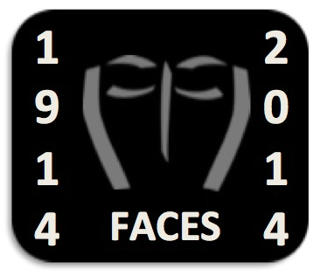
First World War Facial Injury & reconstructive surgery: educational resources pack
University of Exeter
Institut Faire Faces
Marjorie Gehrhardt
David Houston Jones
Catriona Pennell

Slide 2
What are we looking at?
Part 1

Slide 3
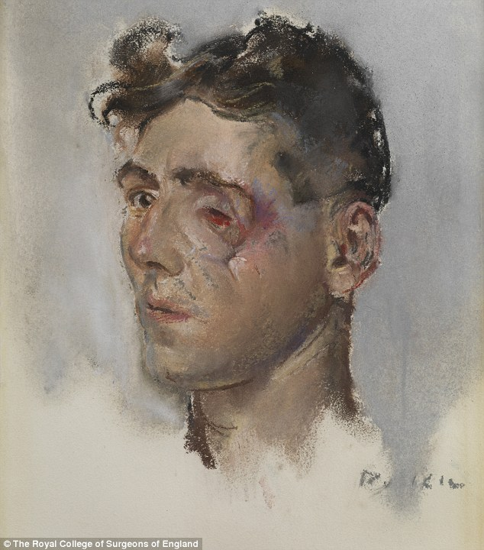

Slide 4
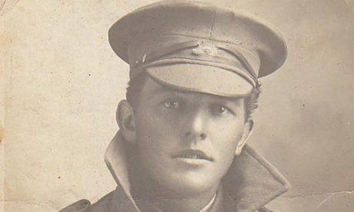
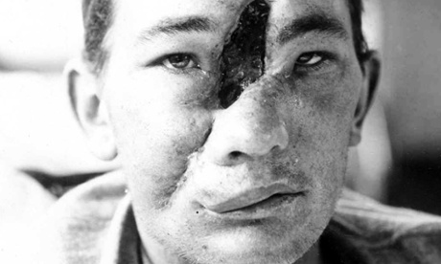
Private Kearsey
Photograph: Australian War Memorial (P10965.001)
Private Kearsey, 13/11/17
Reproduced courtesy of the Royal Australasian
College of Surgeons

Slide 5
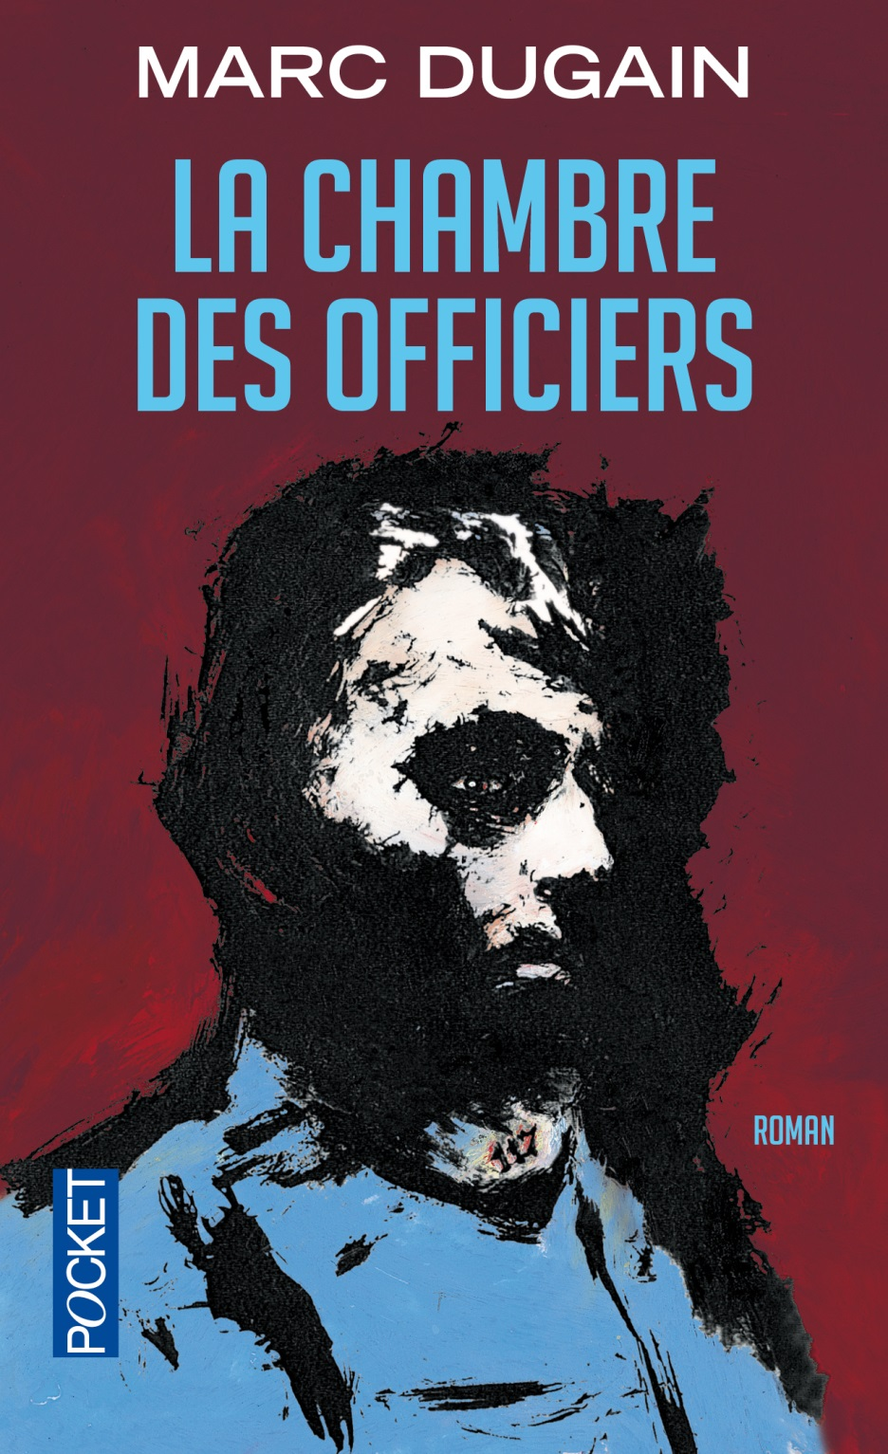
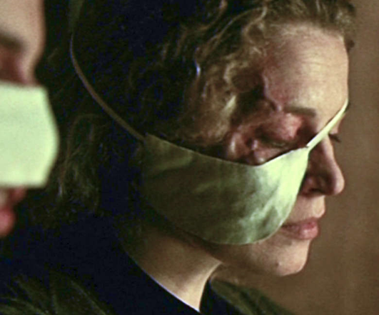
©ARP – France 2 CINEMA
© Éditions Pocket, 2000.

Slide 6
How did this happen? Why were there so many facial injuries in the First World War?
Part 2

Slide 7
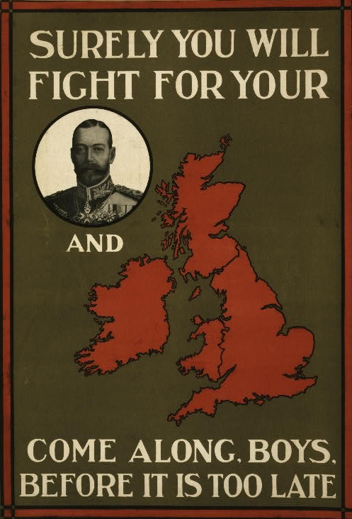
Parliamentary Recruiting Committee, London, c.1914-15.

Slide 8
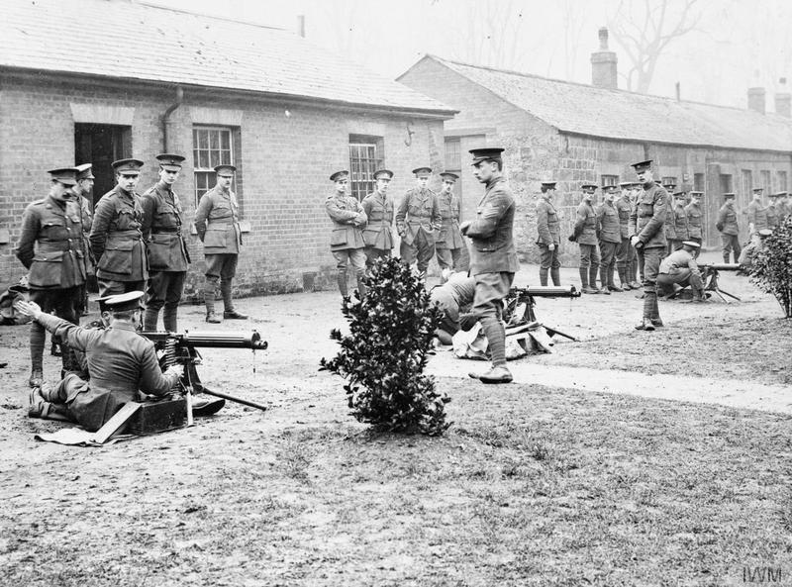
British Army Training in the UK, WWI
© IWM (Q 53550)

Slide 9
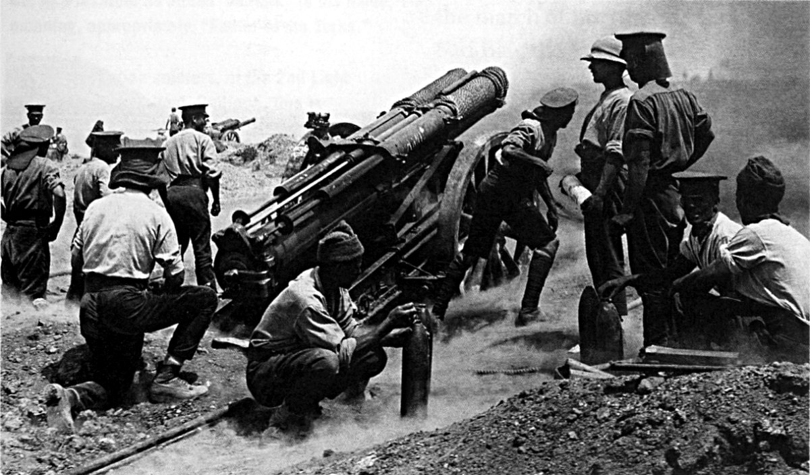
Gallipoli Campaign, 1916
© IWM (Q 13340)

Slide 10
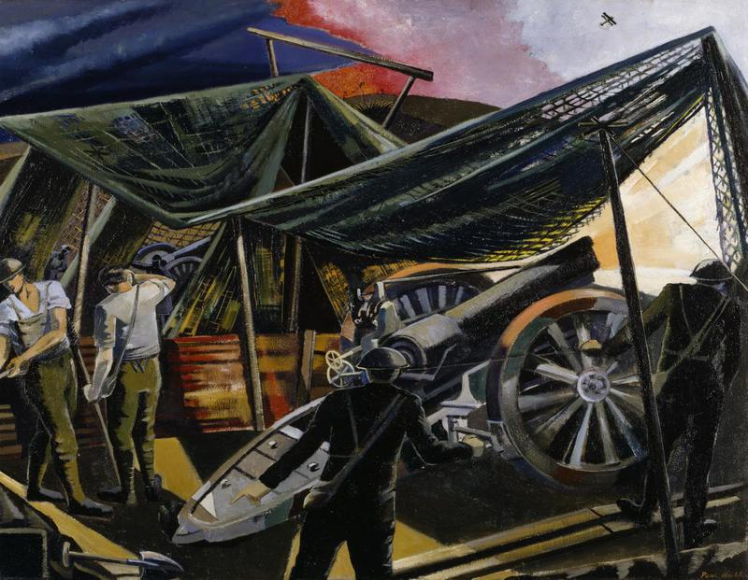
‘A Howitzer Firing’ by Paul Nash (1918)
© IWM (Art.IWM ART 1152)

Slide 11
Plastic surgery in the First World War: ethics & collaboration
Part 3

Slide 12
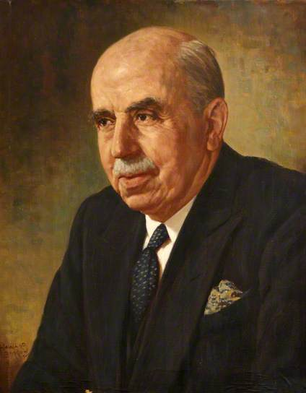
Why was it important to repair the damaged faces?
Harold Gillies portrait by Howard Barron
Harold Gillies’s treatise Plastic surgery of the face:
https://archive.org/details/plasticsurgeryof00gilluoft
Notes:
Return the men to the front as quickly as possible
Avoid disheartening others
Facilitate return home

Slide 13
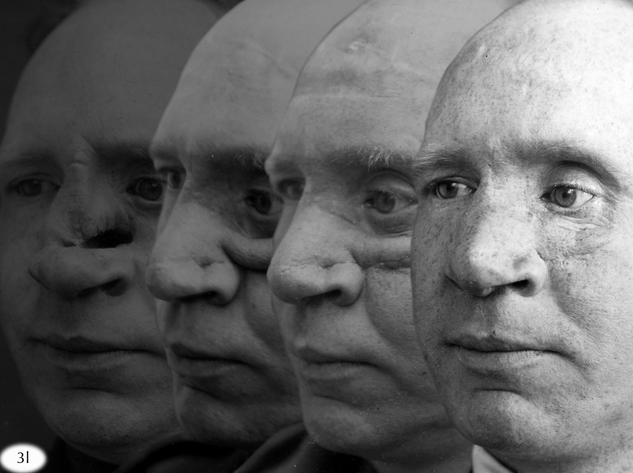
Lieutenant Stacey from the Archives of the Royal College of Surgeons of England courtesy of Paddy Hartley
New techniques: Tubed pedicle

Slide 14
Burns: Walter Yeo
From the Archives of the Royal College of Surgeons of England

Slide 15
From the Archives of the Royal College of Surgeons of England

Slide 16
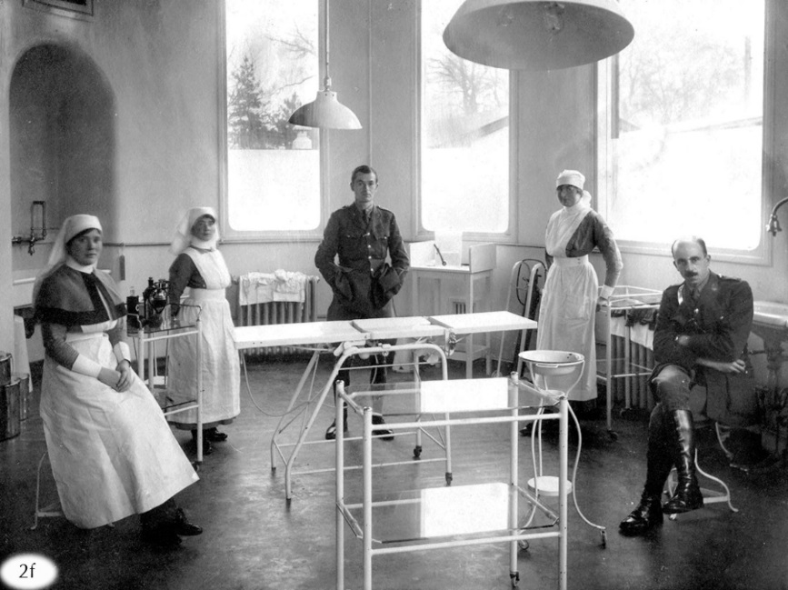
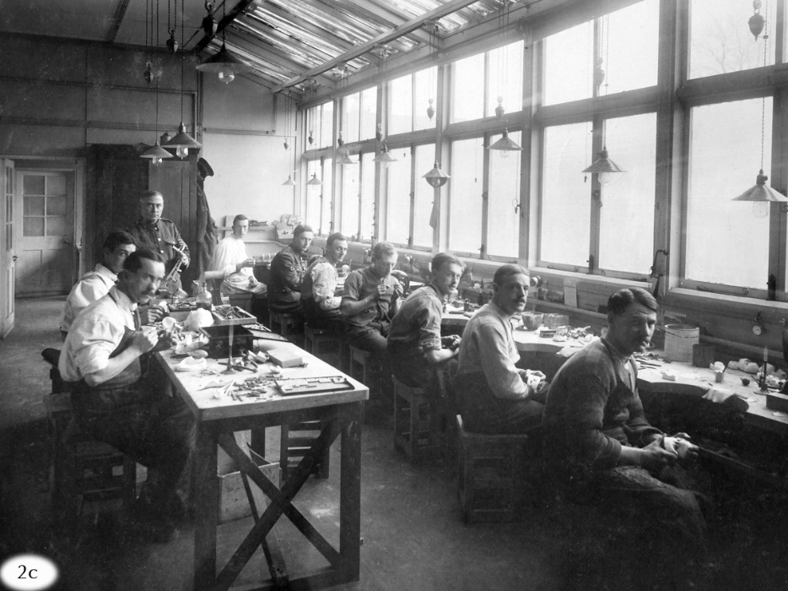
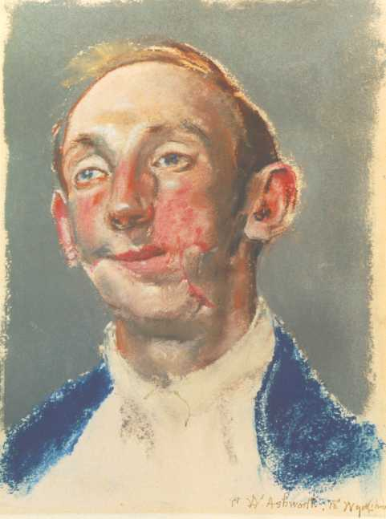
The operating theatre
The dental workshop
Excerpt from Harold Gillies’s preface to his surgery treatise
Tonks pastel of Private Ashworth Hunterian Museum at the Royal College of Surgeons of England

Slide 17
How were they helped?
Part 4

Slide 18
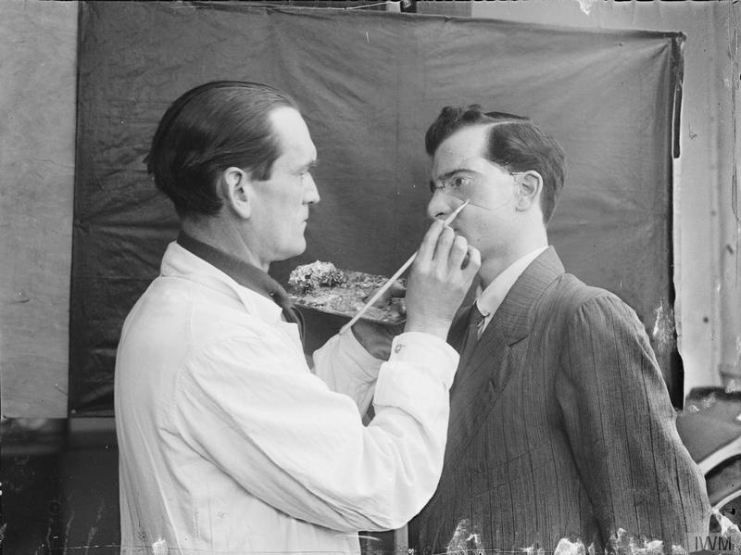
© IWM (Q 30457)
Francis Derwent Wood, applying finishing touches to epithesis © IWM (Q 30457)

Slide 19
Sculptors such as Francis Derwent Wood and Anna Coleman Ladd worked with surgeons.
On the work of sculptor Anna Coleman Ladd in Paris, see:
https://www.youtube.com/watch?v=bCSzrUnie2E

Slide 20
Supporting the patients: the role of nurses
Nurse Catherine Black, who worked with Harold Gillies, remembers:
[…] it is not so hard to see a man die as to break the news to him that he will be blind and dumb for the rest of his life. And that was something we had to do so often in that silent ward where only one in every ten patients could mumble a few words from the shattered jaws, for the facial wounds were in many respects the most serious of the War casualties.[…]
The problem of feeding was acute, for very few of the patients in that ward could take even a particle of anything solid, and yet their strength had to be kept up at all costs. So we had to ring the changes as best we could in two-hourly feeds...tomato soup made with milk, Benger's food, iced coffee, egg flip. Often we would use as many as three hundred eggs a day in that ward alone. The VAD's worked like blacks all day long, cooking and clearing away, for no sooner was one feed finished than it was time to start preparing another.
Hardest of all was the task of trying to rekindle the desire to live in men condemned to lie week after week smothered in dressings and bandages, unable to talk, unable to taste, unable even to sleep.
Catherine Black, King’s Nurse – Beggar’s Nurse, pp. 85-86

Slide 21
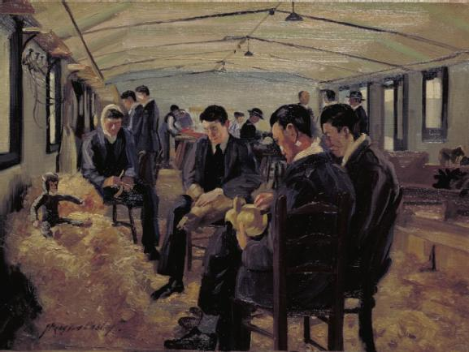
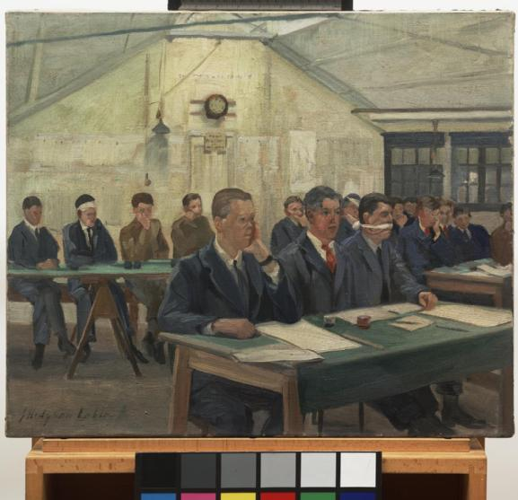
Training workshops
The toy-makers’ shop
Painting by John Hodgson Lobley
© IWM
The commercial class
Painting by John Hodgson Lobley
© IWM

Slide 22
How did people react?
Part 5

Slide 23
The reactions of others on the battlefield:
‘Mr Rawson, with a terribly scared and horrified look, rushed back for a moment (all credit to him!) to tear out the packet containing the field dressing which every man carried sewn in the lining of his tunic. […] Perhaps he was panic-struck at my appearance […]’
‘A corporal with a stretch-bearing party were standing round me. This corporal however would not allow them to take me as he thought by the look of me that I had a stomach wound. I heard him tell his men it wouldn’t be worth wile carrying me all that blankety distance as “that sort always dies soon”. A second party my friend brought along also refused me.’
Private papers of Percy Clare, IWM
A ward orderly’s difficulties to look at facially wounded men:
‘An English war-hospital, on the whole, furnishes forth fewer horrible sights than happy ones. But there is one perturbing experience which, for the worker in w=such an institution, is inevitable. It is this. He finds that he must fraternise with fellow-men at whom he cannot look without the grievous risk of betraying, by his expression, how awful is their appearance. Myself, I confess that this discovery came as a surprise. I had not known before how usual and necessary a thing it is, in human intercourse, to gaze straight at anybody to whom one is speaking, and to gaze with no embarrassment.’
Ward Muir, The Happy Hospital

Slide 24
A mother’s first reaction:
‘On the day they were taken off his mother visited him. She went very white and I thought for a moment that she was going to faint, but not the slightest expression of face or voice betrayed her. She went on talking unconcernedly as though she had not realized that her son would always be terribly disfigured for as long as he lived. Captain Gillies had done everything that was humanly possible, but he could not work miracles.’
Catherine Black, King’s Nurse, Beggars’ Nurse
A 1917 newspaper article :
‘No effort must be spared to give these men – many of them mere lads – a fresh interest and a new start in life – preferably in the country, and make them realise that they are not useless wrecks. If this is not done, many will drift to the towns on their discharge from the services, only to become mere objects of pity and frequently the recipients of misdirected charity.’
The Queen’s New Hospital for Treatment of Severe Facial and Jaw Injuries’, January 1917, LMA H02/Y01/05, p. 1

Slide 25
Credits
Images of Private (Pte) William Kearsey courtesy of Australian War Memorial and the Royal Australasian College of Surgeons
Images by Henry Tonks © Hunterian Museum at the Royal College of Surgeons of England
Images from Harold Gillies medical files are from the Archives of the Royal College of Surgeons of England
Cover image, Marc Dugain, La Chambre des officiers, © Éditions Pocket, 2000
Image from La Chambre des officiers film ©ARP – France 2 CINEMA
Imperial War Museum images are used under the terms of IWM Non-Commercial Licence @IWM
Grateful thanks to Jane Frances (Changing Faces), Simon Robbins (Imperial War Museum) and Florie Dournel (Conseil Général de la Somme).
The Operating Theatre and The Dental Workshop courtesy of Dr Andrew Bamji

