Slide 1
JOHN SOMERS
Payhembury

Slide 2
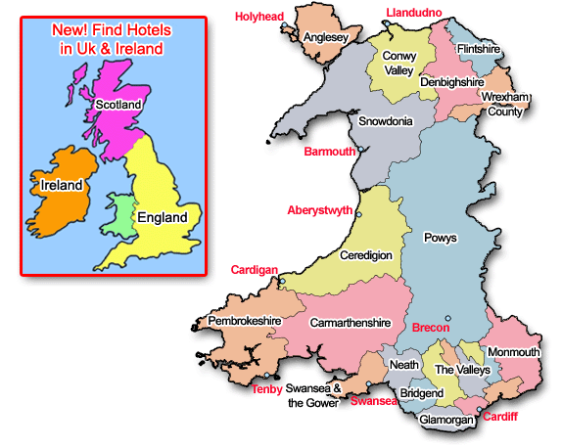

Slide 3
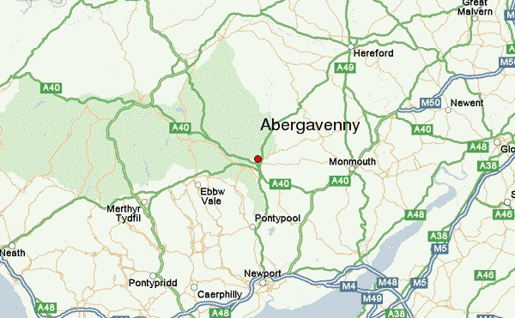

Slide 4
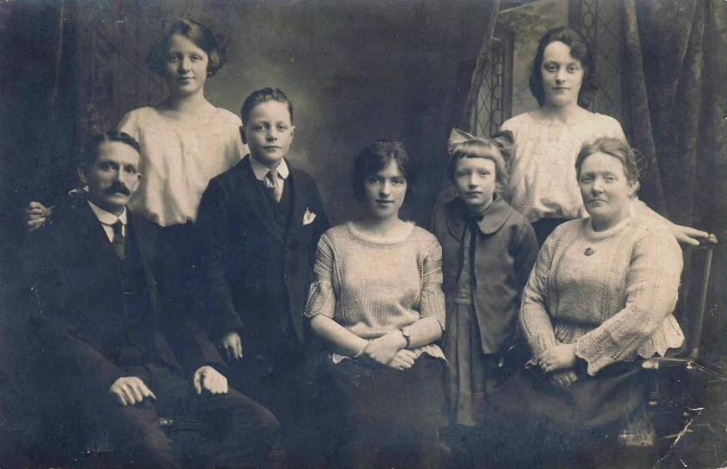
Gilmore family.
Left to right: Gramper Gilmore (miner, Abertillery), Aunty Doll, Uncle George, Aunty Gwen, Aunty Vera, Lily Somers (Mam), Gran Gilmore (nee Workman).

Slide 5
Gilmore family.
Left to right: Gramper Gilmore (miner, Abertillery), Aunty Doll, Uncle George, Aunty Gwen, Aunty Vera, Lily Somers (Mam), Gran Gilmore (nee Workman).

Slide 6
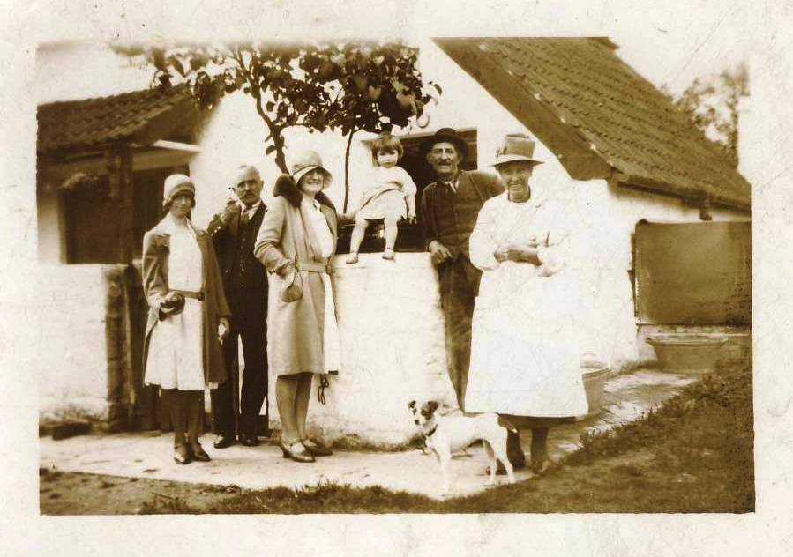

Slide 7
Great Oak, Bryngwyn, near Abergavenny, Monmouthshire

Slide 8
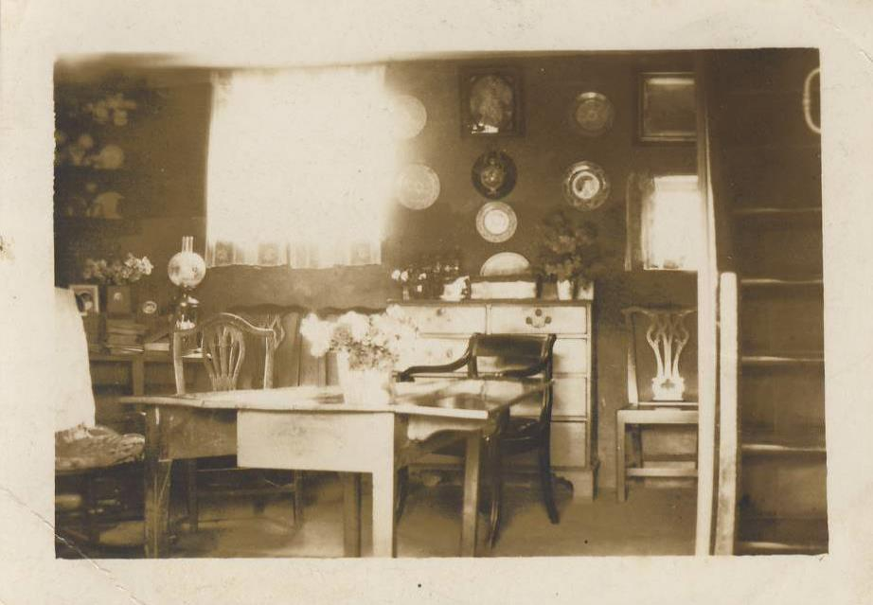

Slide 9
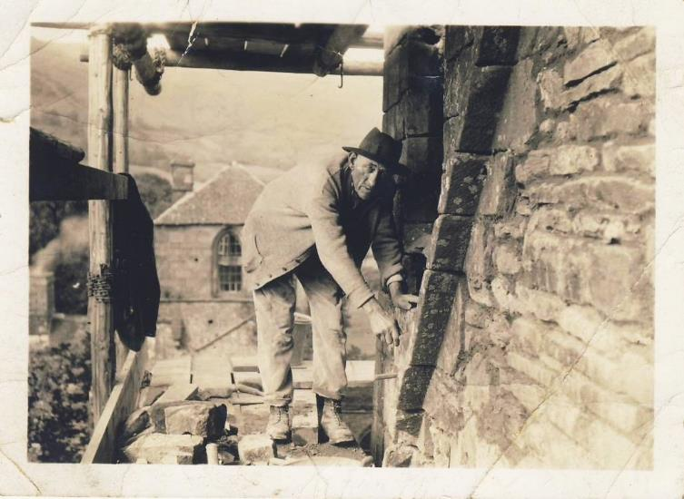
Llanthony Abbey

Slide 10
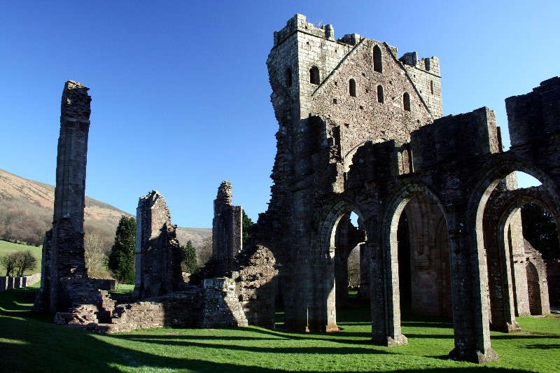
Llanthony Abbey

Slide 11
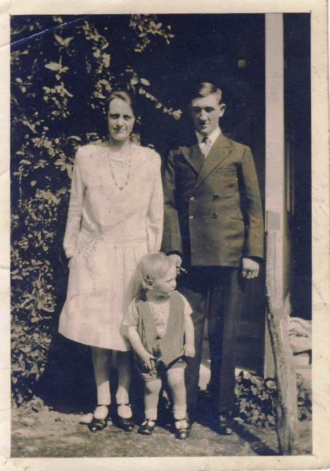

Slide 14
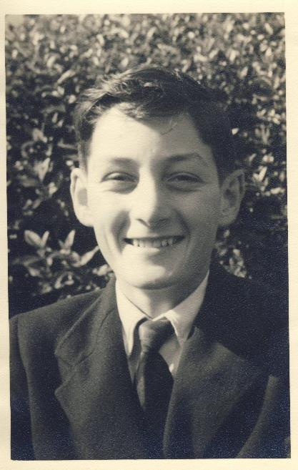
John Somers, first year at King Henry V111 Grammar School, Abergavenny.

Slide 15
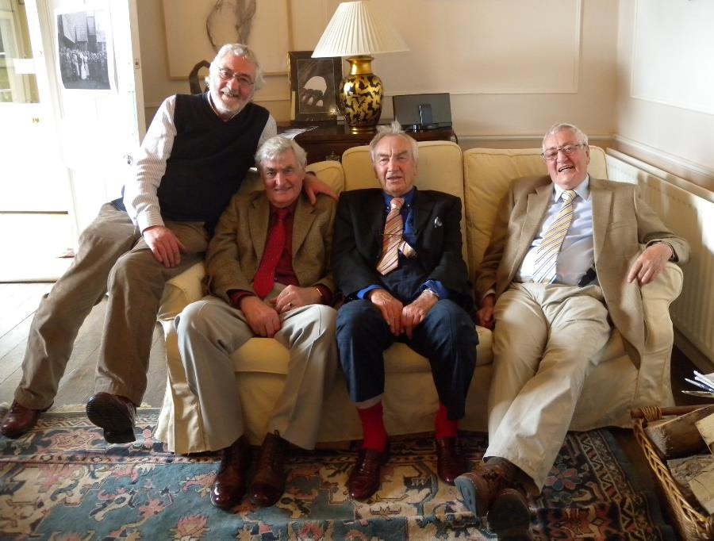

Slide 17
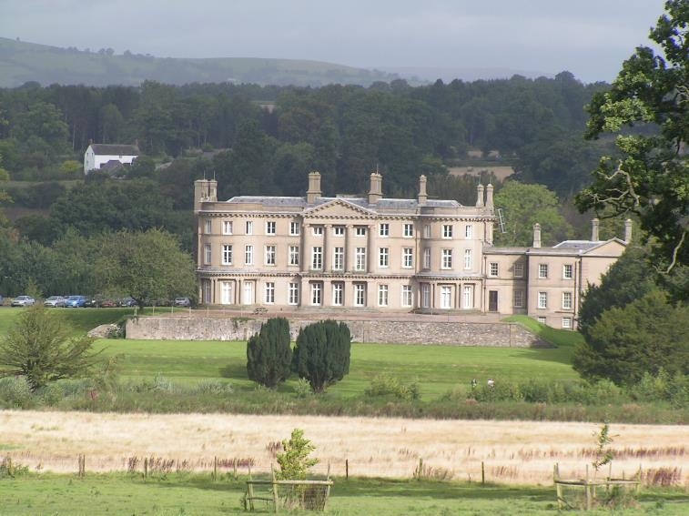
Llanarth Court

Slide 18
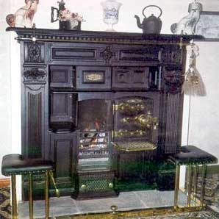
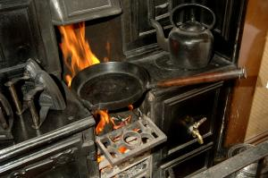

Slide 19
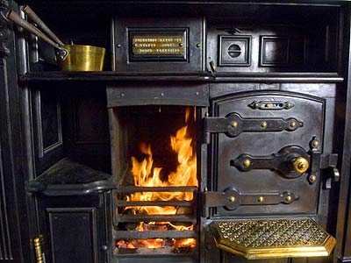

Slide 20
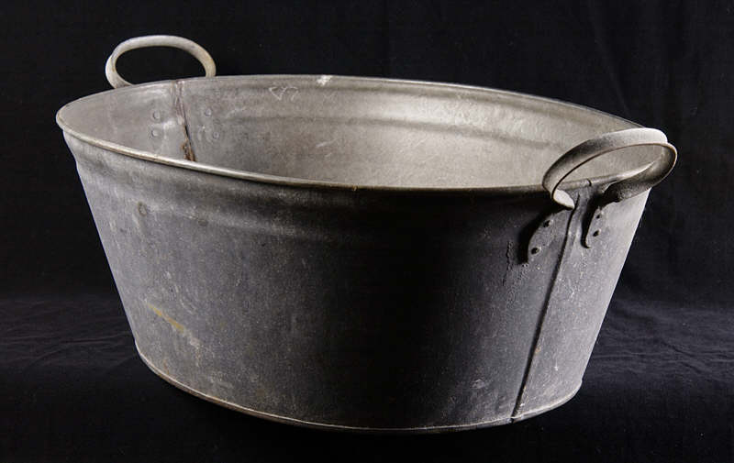

Slide 21
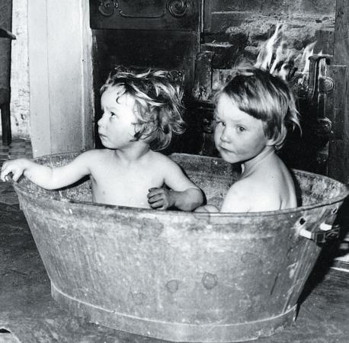

Slide 22
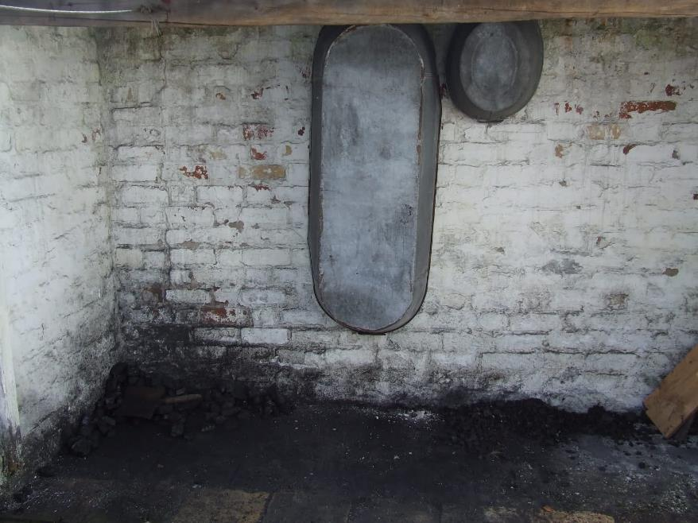

Slide 23
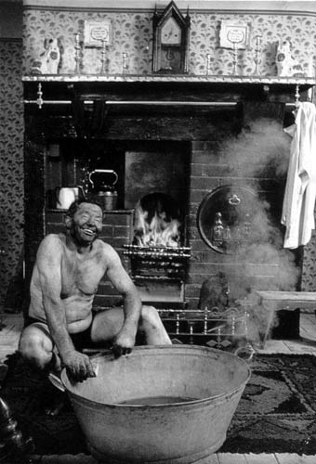

Slide 24
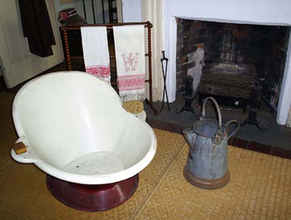
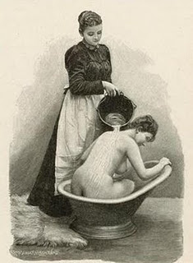
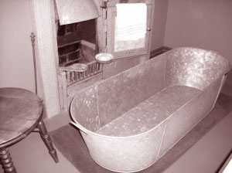

Slide 25
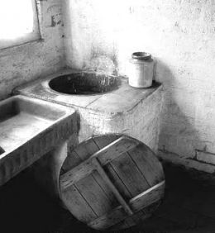
Wash House

Slide 26
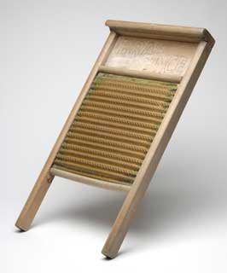
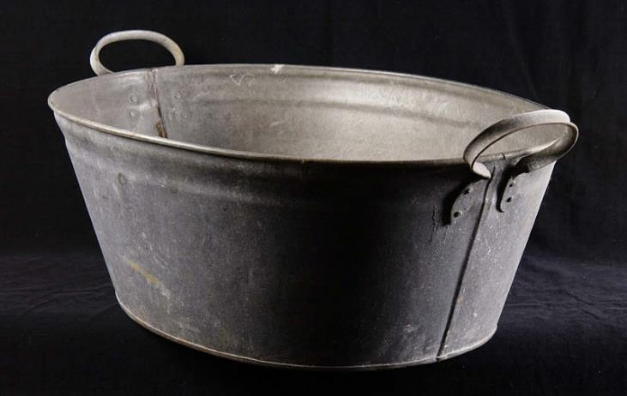

Slide 27
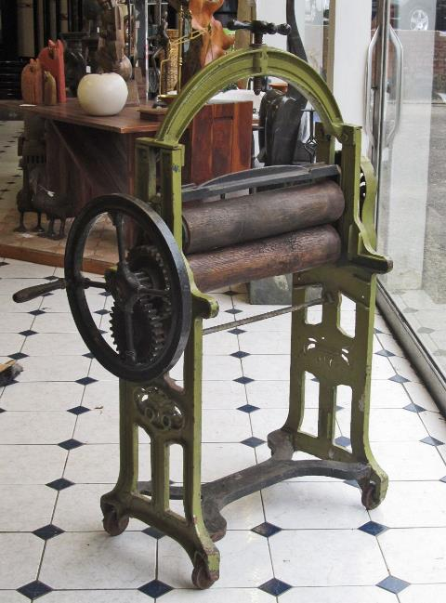

Slide 28
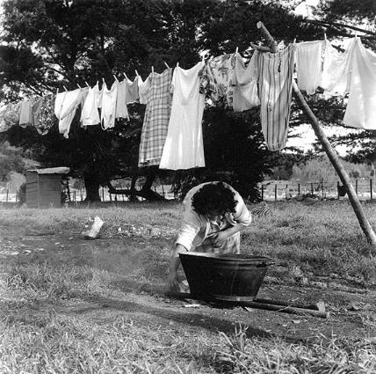
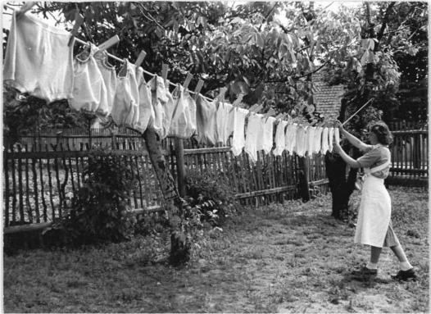

Slide 29
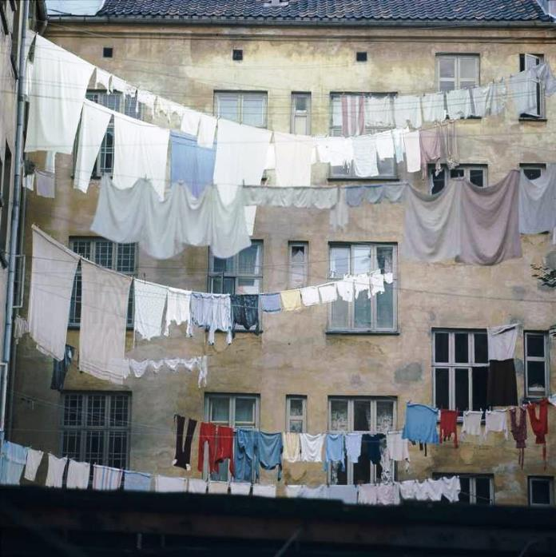

Slide 30
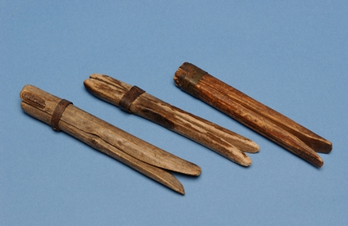
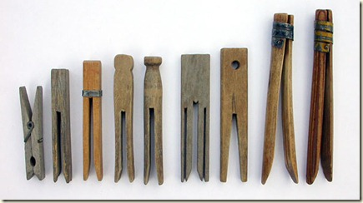

Slide 31
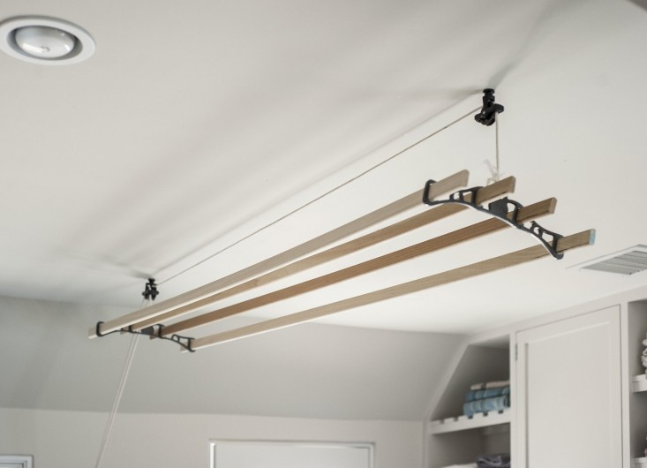

Slide 32
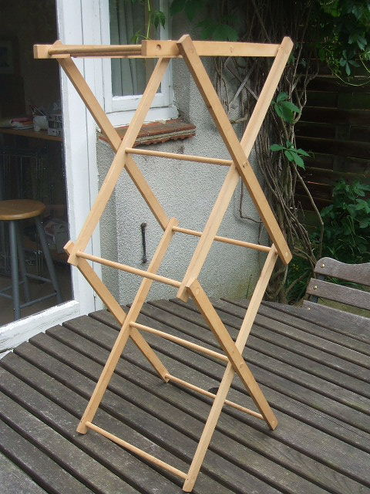
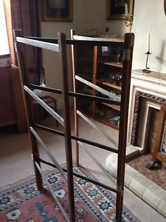

Slide 33
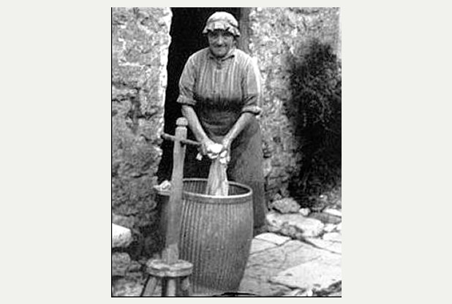
Dolly tub in use

Slide 34
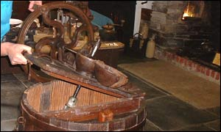
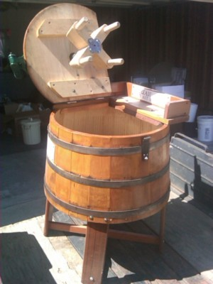
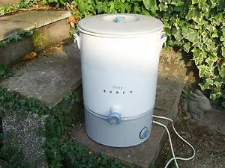

Slide 35
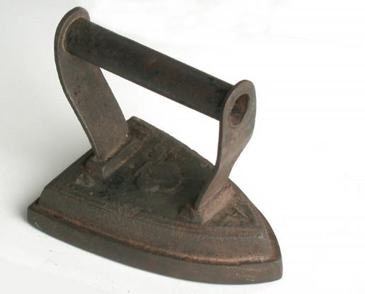
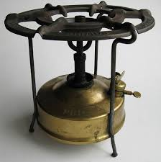

Slide 36
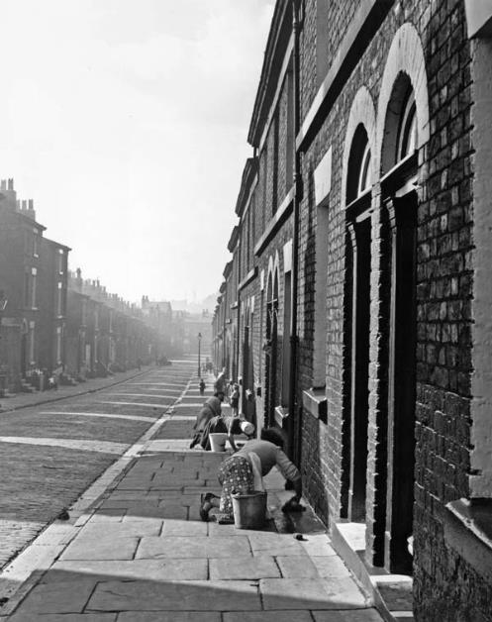

Slide 37
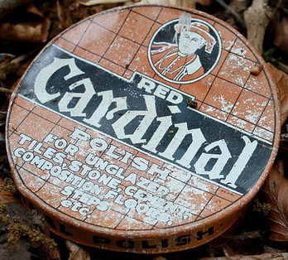

Slide 38
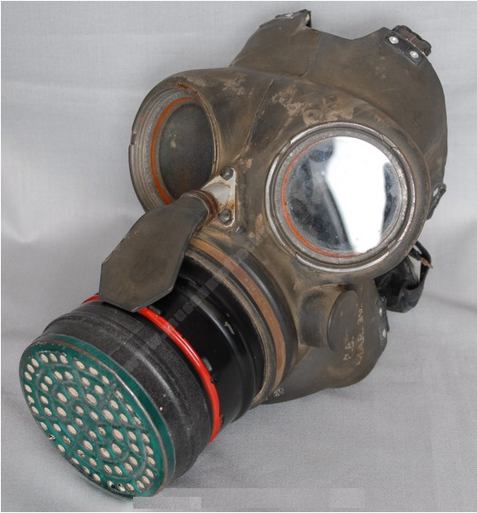

Slide 39
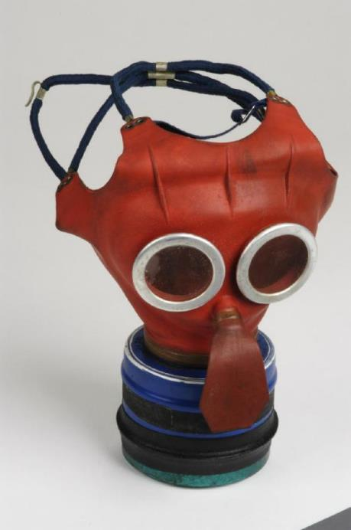

Slide 40
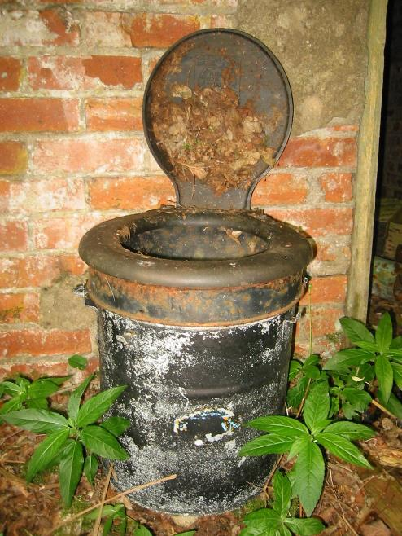

Slide 41
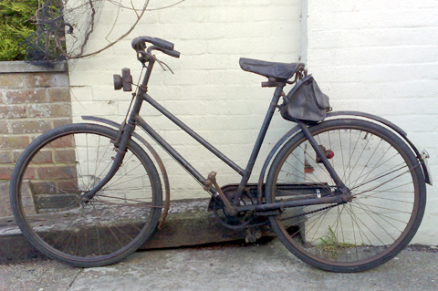

Slide 42
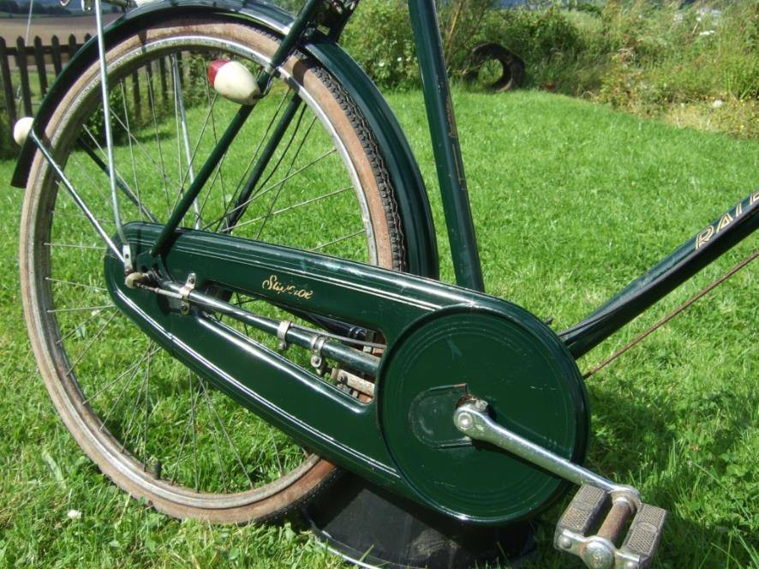

Slide 43
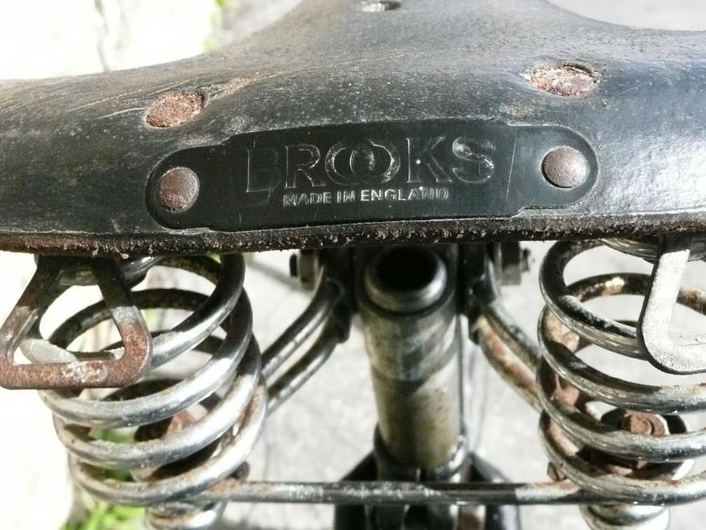

Slide 44
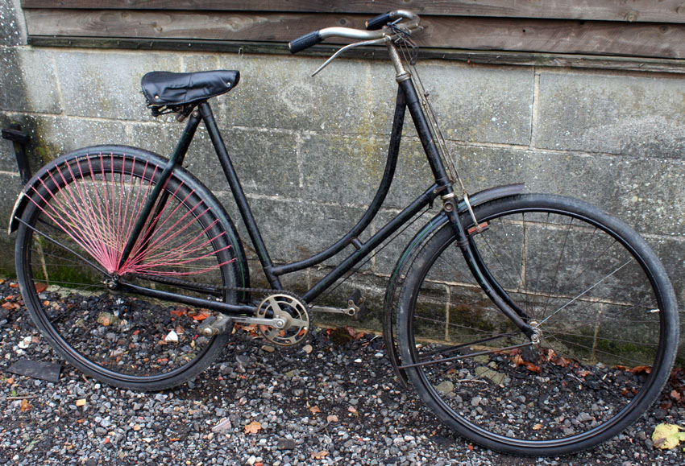

Slide 45
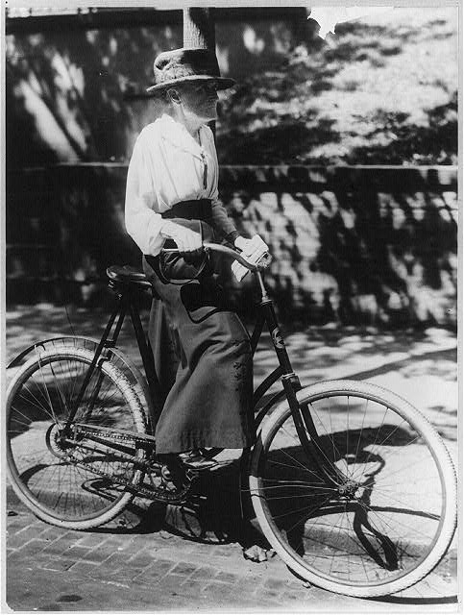

Slide 46
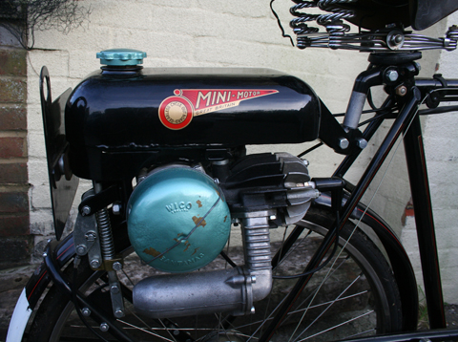

Slide 47
NORTON

Slide 48
Vincent

Slide 53
Gramophone

Slide 55
Radiogram

Slide 56
Valve Radio

Slide 58
Arthur English
“Mum. They're laughing at me!"

Slide 60
Jimmy Jewell and Ben Warriss
BBC radio series ’Up the Pole’

Slide 62
Vera Lynn

Slide 63
We'll meet again, Don't know where, Don't know when But I know we'll meet again some sunny day Keep smiling through, Just like you always do Till the blue skies drive the dark clouds far away.

Slide 64
So will you please say "Hello" To the folks that I know Tell them I won't be long, They'll be happy to know That as you saw me go I was singing this song.

Slide 65
We'll meet again, Don't know where, Don't know when But I know we'll meet again some sunny day.

Slide 67
The Goons
Spike Milligan, Peter Sellers, Harry Secombe

Slide 69
Ted Ray

Slide 71
Tommy
Trinder

Slide 73
Arthur Askey

Slide 75
Jimmy
Edwards

Slide 85
Water Shute

Slide 88
“They try to tell us we’re too young Too young to really be in love They say that love’s a word, a word we’ve only heard But can’t begin to know the meaning of. And yet we’re not too young to know This love will last though years may go And then someday they may recall We were not, too young, at all.”

Slide 89
Nat King Cole: 1951

Slide 91
Modern digital radio with docking for iPod and IPhone.

Slide 96
Hey Jude, don't make it bad Take a sad song and make it better Remember to let her into your heart Then you can start to make it better.

Slide 98
The Everly Brothers

Slide 99
D-r-e-a-m, dream, dream, dream D-r-e-a-m, dream, dream, dream
When I want you in my arms When I want you and all your charms Whenever I want you, all I have to do is D-r-e-a-m, dream
When I feel blue in the night And I need you to hold me tight Whenever I want you All I have to do is d-r-e-a-m

Slide 100
I can make you mine, taste your lips of wine Anytime night or day Only trouble is, gee whiz I’m dreaming my life away
I need you so that I could die I love you so and that is why Whenever I want you, all I have to do is Dream, dream, dream, dream, dream
D-r-e-a-m, dream, dream.

Slide 102
Elvis Presley

Slide 103
Jiving
Rock and Roll.
Bill Haley and his Comets.
‘Rock around the Clock’

Slide 105
The Lone Ranger

Slide 107
Tonto

Slide 109
Tony Hancock

Slide 110
Tony Hancock joke
"I don't want any publicity – you get too many begging letters. If they're anything like the ones I send out I don't want to know!"

Slide 112
Sid James

Slide 114
Bob Monkhouse

Slide 115
Two of Bob
Monkhouse’s
jokes ……….

Slide 116
"They used to laugh when I said I wanted to be a comedian ……….. well they're not laughing now."

Slide 117
My wife said: 'Can my mother come down for the weekend?' So I said: 'Why?' and she said: 'Well, she's been up on the roof two weeks already'.

Slide 118
JOHN SOMERS
Payhembury

Slide 121
Jigsaw

